Slide 1
Kōwhai-Ngutu-Kākā
Ranga Tuhi (Waikato, Ngāti Maniapoto)
2010 Alumni symposium
Pitau Pattern on marae poupou (wall panels) and kowhaiwhai patterns on heke (roof panels)
Based on symbolism of Te Poutūārongo carving situated at Te Kuratini Marae, Massey University (Wellington Campus)
Papatuānuku (Earth Mother) and Hine-nui-te-pō (Goddess of the Night)
Unaunahi (fish scales) – rhythm and movement
Pitau bulb – Tangaroa, God of the Sea

Slide 2
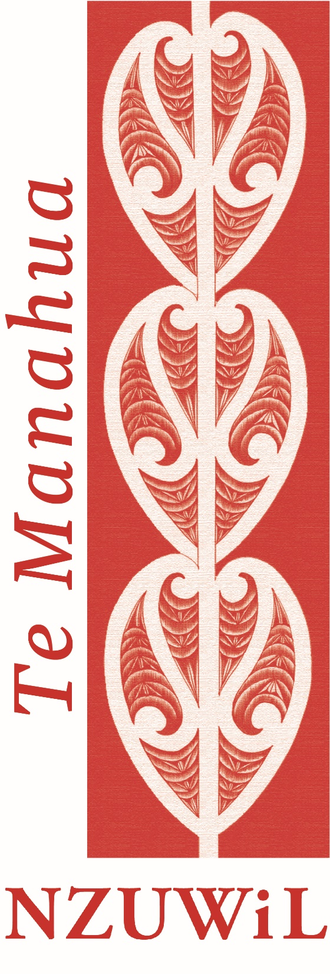
Te Manahua - NZUWiL
Prof. Rawinia Higgins (Tūhoe) and Dr Meegan Hall (Ngāti Ranginui, Ngāti Tūwharetoa)
Expresses the moment when petals open, grow and blossom into a flower
Aligns with waitohu Kōwhai-Ngutu-Kākā
Symbolises the mana of female deities
Importance of women leaders giving of their time, knowledge and experiences to teach and tautoko the next generation.
Mana – alludes to power, authority and status
Hua – outcomes, results, benefits
Encourages wāhine to build their capacity, realise their value, and reach their full potential

